Slide 1
LIBS – PEEC 2022
Pedro A.S. Jorge, Nuno Azevedo Silva

Slide 2
LIBS - A spectroscopy technique
LIBS Stands for Laser Induced Breakdown Spectroscopy
and it is in short a spectroscopy technique.

Slide 3
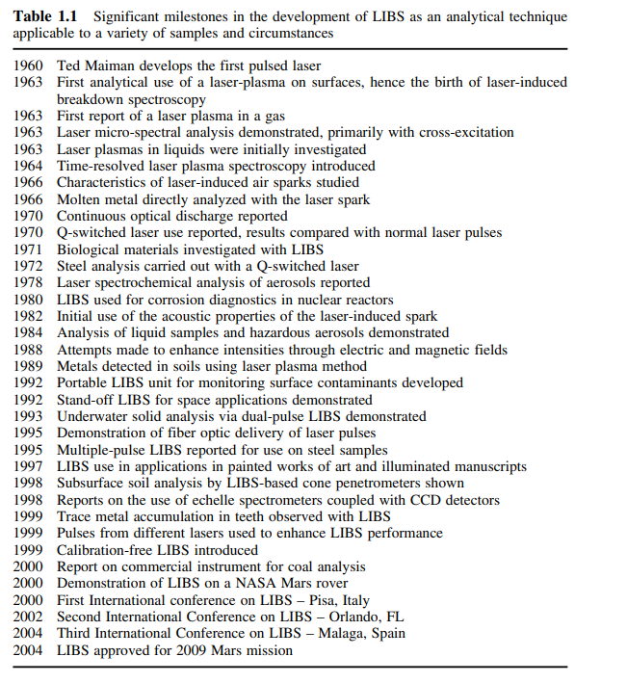
From 1963 to 2022

Slide 4
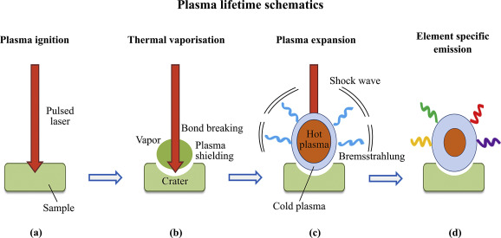
The process
Laser induced Ablation of the material (mJ range for ns, uJ range for ps)
Vaporisation
Plasma breakdown, expansion
Continuous emission (Bremsstrahlung)
(500us) Line Emission

Slide 5
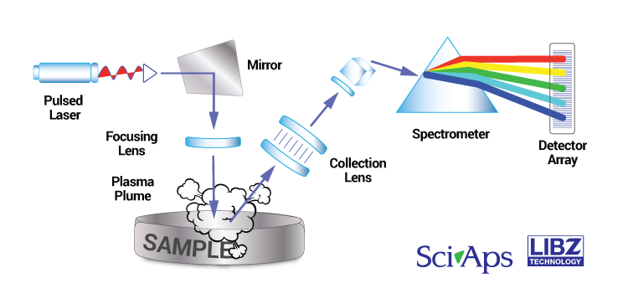
A typical prototype
Laser + Focusing system (Lens, MO)
2.Spectrometer (Collection Lens + Grating + Detector Array: CMOS,CCD – low SNR, integration time (10 us to ms), iCCD – few photons, smaller integration time(ns) )

Slide 6
Typical parameters - Laser
Pulse Energy(few mJ, typically controlled with Q-Switch)
Wavelength (1064nm)
Pulse duration(few ns)
Repetition Rate (few Hz)

Slide 7
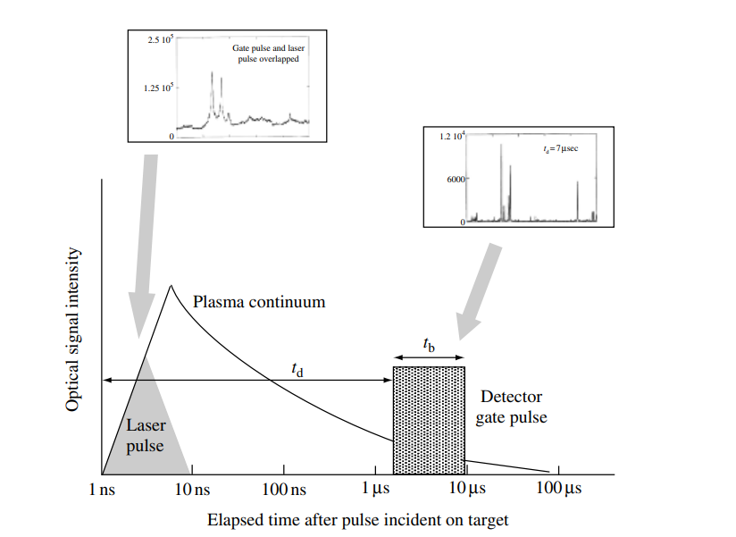
Parameters - Spectrometer
Wavelength range
(350nm to 900nm)
Gate Integration time (50us to 1ms)
Gate delay (50us) - remove the continuous emission

Slide 8
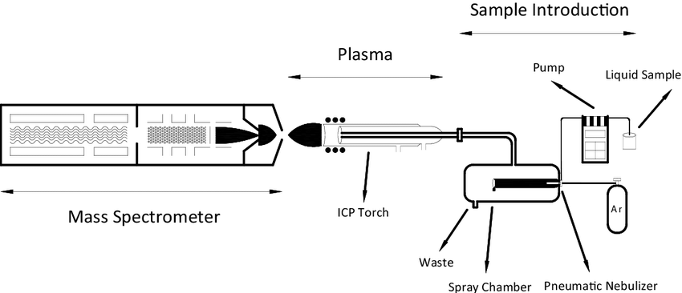
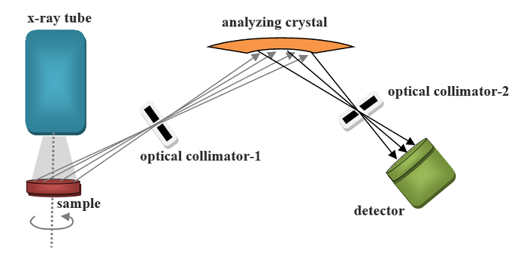
Applications
Spectroscopic technique for Chemical analysis
Competitors:
ICP-MS (requires sample preparation, pricey, hours),
X-Ray (does not work for light elements, takes large operation times(minutes))

Slide 9
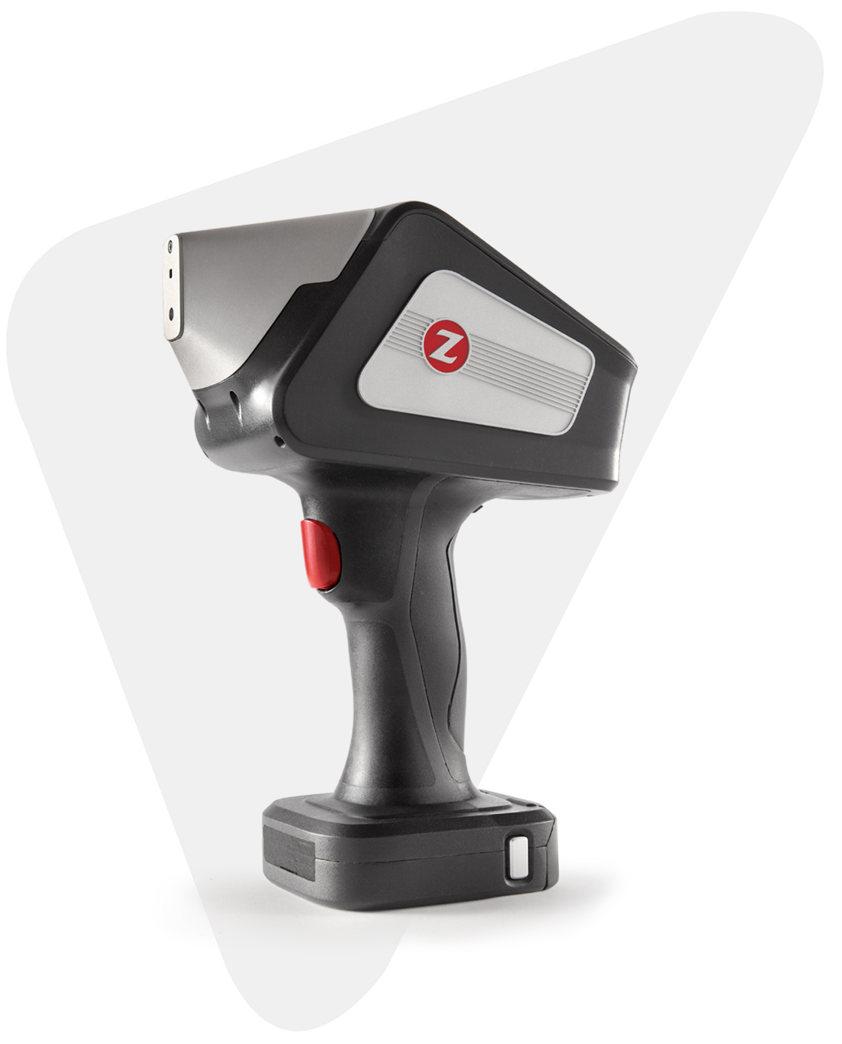
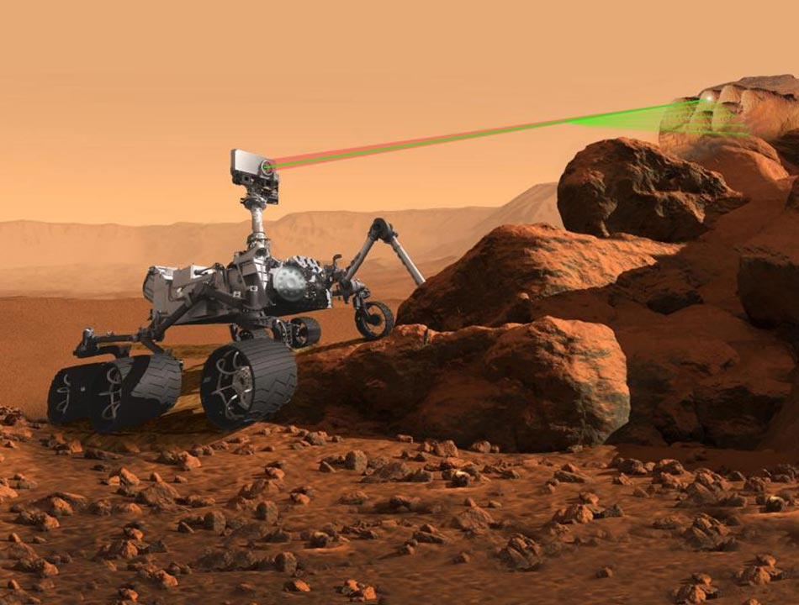
Advantages of LIBS
Allows to detect virtually every element
Fast, high throughput
Relatively cheap (operation costs)
Portable
Easy to integrate in industry applications
No sample preparation
Low damage (micrometer size)
Allow micrometer precision (mapping)
Remote operation (Standoff LIBS, Underwater, etc)
Extreme environments – e.g. Mars

Slide 10
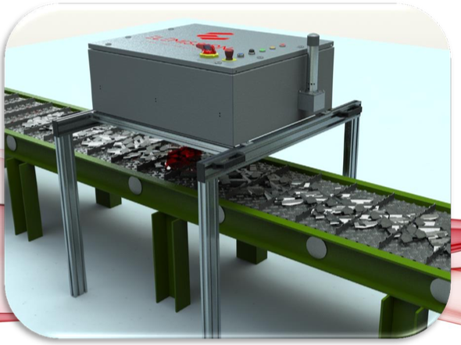
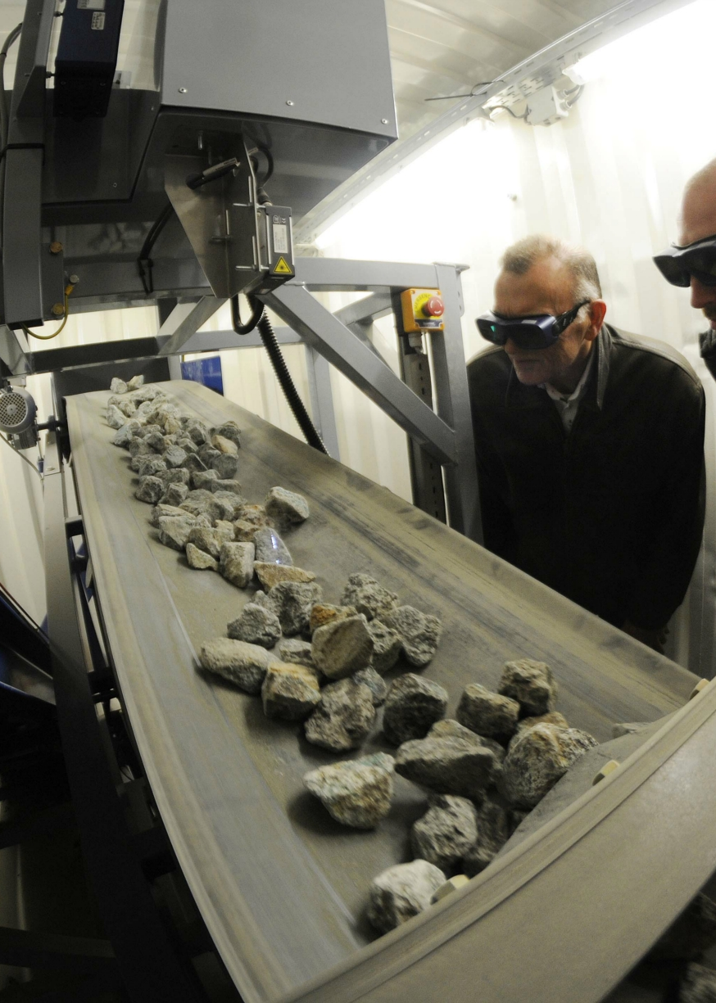
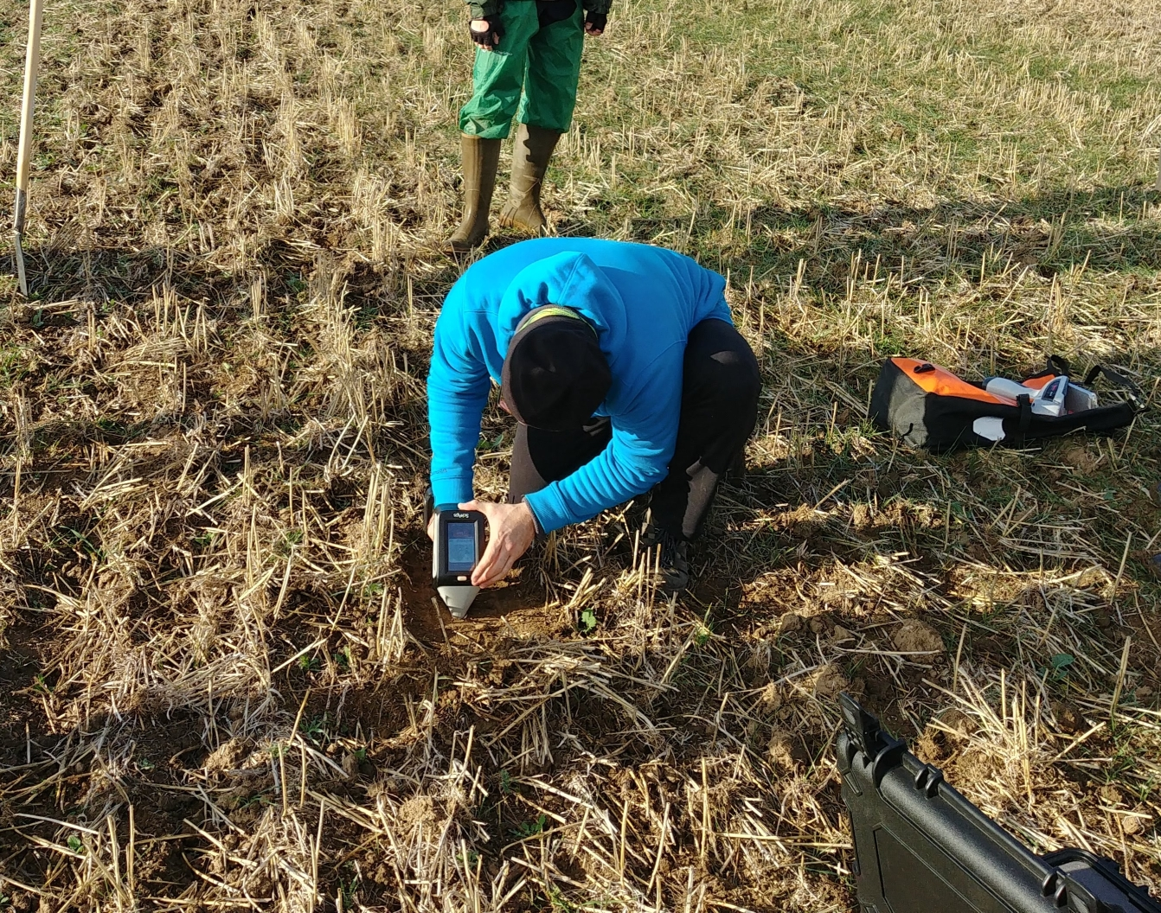
Applications
Scrap metal industry
Mining
Plastic industry
Agriculture (soils)
Heritage
Etc…

Slide 11
What can LIBS really do?
Qualitative Analysis
Semi-quantitative Analysis
Quantitative Analysis

Slide 12
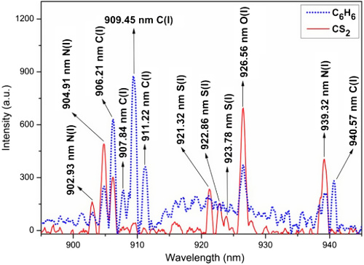
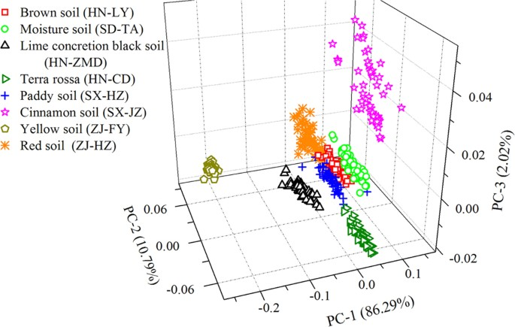
Qualitive Analysis
1. Presence of elements
Identification of emission lines
Seek for exclusive lines
Empirical Criteria: 3/5 highest emission peaks
2. Sample type identification and classification
Machine learning algorithms to classify samples

Slide 13
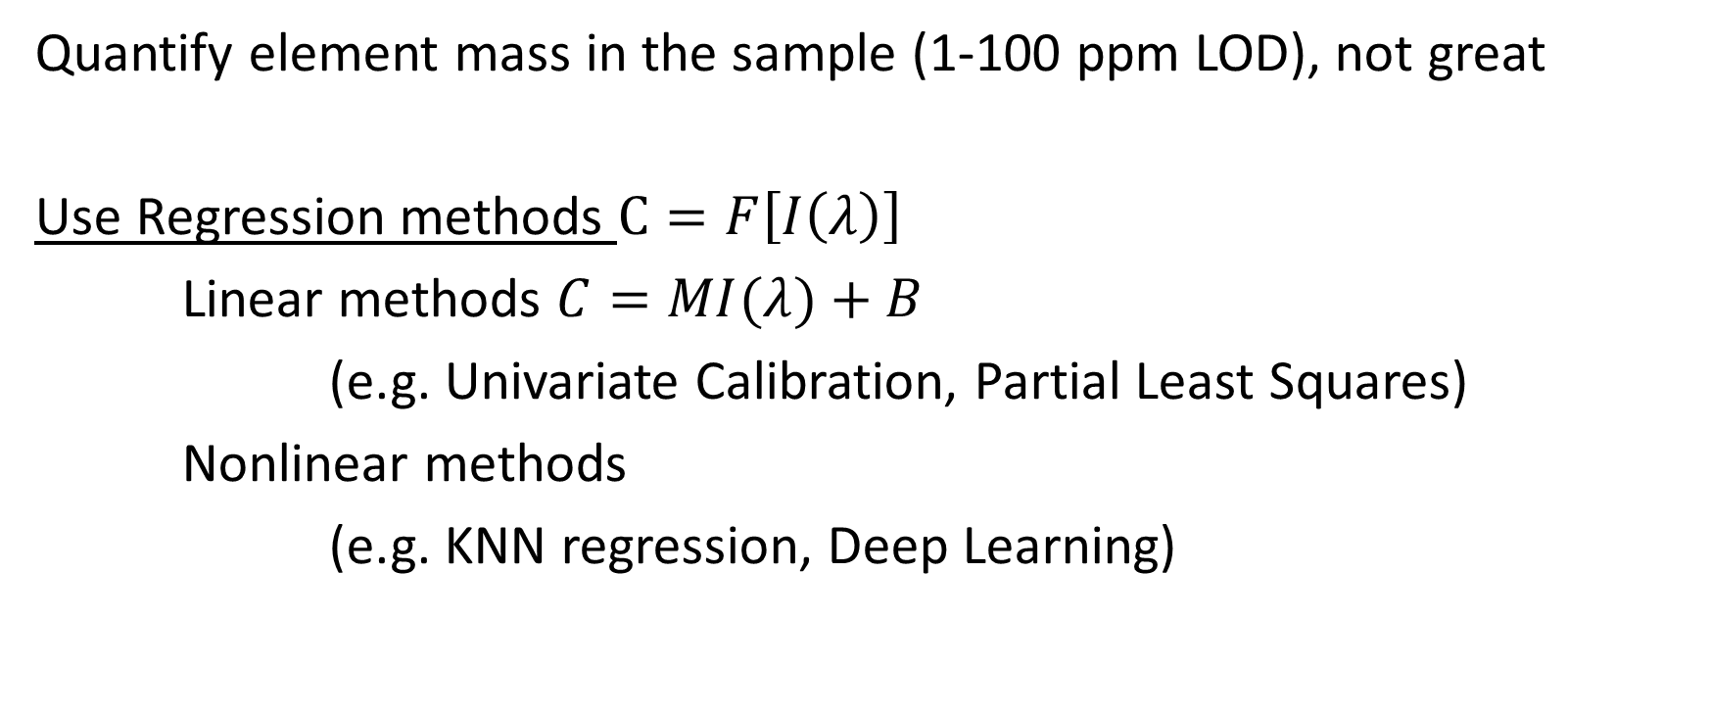
Quantitative Analysis
Quantify element mass in the sample (1-100 ppm LOD), not great
Use Regression methods $C=F\left[I\left(λ\right)\right]$
Linear methods $C=MI(λ)+B$
(e.g. Univariate Calibration, Partial Least Squares)
Nonlinear methods
(e.g. KNN regression, Deep Learning)

Slide 14
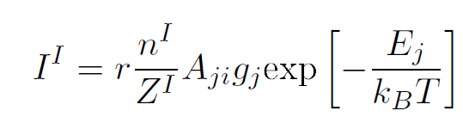
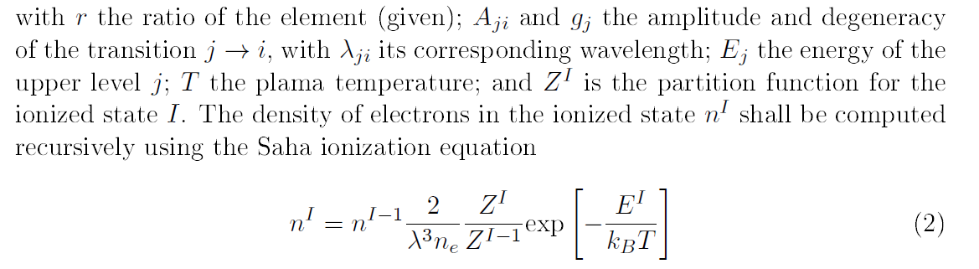
Some theoretical basis for quantification
Boltzmann equation + Saha ionization equation gives that the intensity of a given line

Slide 15
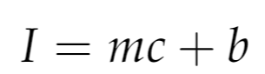
Some theoretical basis for quantification
Linear calibration model!
However this is only valid for a plasma in thermal equilibrium + homogeneous, usually not the case!

Slide 16
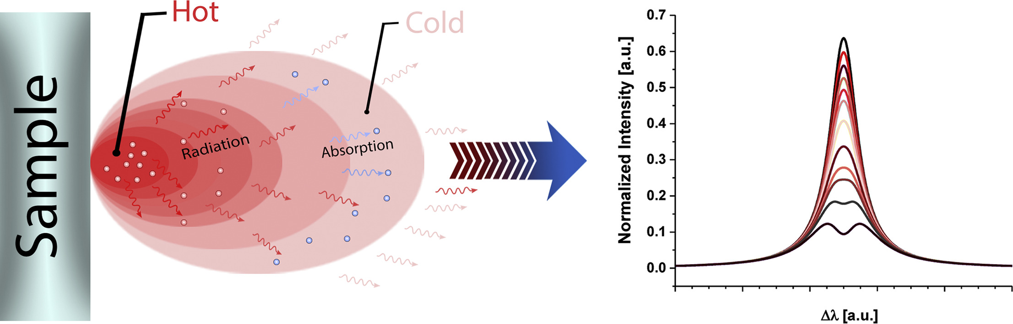
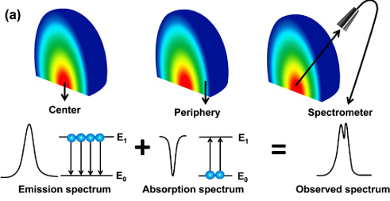
When the plasma is not in the LTE
Self-absorption happens
Or even more dramatic, self-reversal

